Slide 1




Big Data Ecosystem
Technical Deep Dive

Slide 2


Sashank Pappu
Azure Data & AI Specialist.
Certified from MIT on ‘Advanced Analytics and Big Data Challenges’. Technology Enthusiast and Data Specialist. Certified Designer in Computer Vision
• Microsoft Certified Azure Data Architect. • Microsoft Certified Azure Machine Learning Developer • Certified on Practical Data Analytics with Microsoft Cortana Intelligence Suite.
9+ years of total experience as Data Specialist and Data Engineer.
Certifications
Experience
Currently working as Independent Consultant on Azure Data & AI and Enterprise Trainer on Azure Data Analytics , Cortana Intelligence Suite and Cognitive Sciences
Expert facilitator and corporate behavioral trainer with 5 years of experience in designing programs, content development , Data Analytics and Machine Learning.
Role
Training
Sri Nag Sashank
Co-Founder & CTO of antz.ai , a niche Data & IoT company.

Slide 3
What shall we learn today ?
Azure Data Bricks Understanding & Scalability
Data Bricks Delta
Data Lake Integration with Data Bricks
Streaming Data using Data Bricks

Slide 4
More Detailed Agenda
11-11:30 AM :
11:30-12:00 :
12:00-1:00 :
1:00 – 1:30 :
DevOps & ADF
Understanding on Databricks
Read & Write Data Bricks Mounting Blob & Data Lake

Slide 5





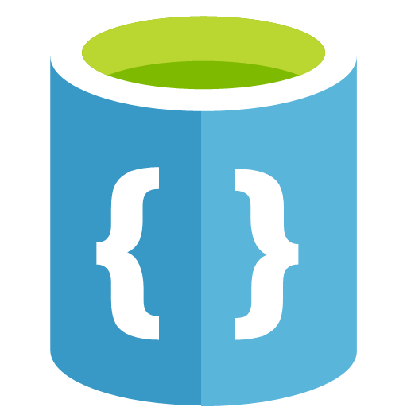

Distributed storage PaaS on Azure
Errr….
What are all these? Why so many?
When do I use these?
Wait, now you have this new thing called *Delta*? I am dizzy and ready to pass out!
MPP database Object store
No-SQL

Slide 6

Scalable OLTP, IoT store, time series database
Fit for purpose
MPP database
No-SQL
Object store

Slide 7



Datawarehousing
Fit for purpose
MPP database
No-SQL
Object store

Slide 8
Data Lake
Fit for purpose
MPP database
No-SQL
Object store

Slide 9








Analytics store – structured, unstructured
Fit for purpose
MPP database
No-SQL
Object store
Databricks Delta

Slide 10

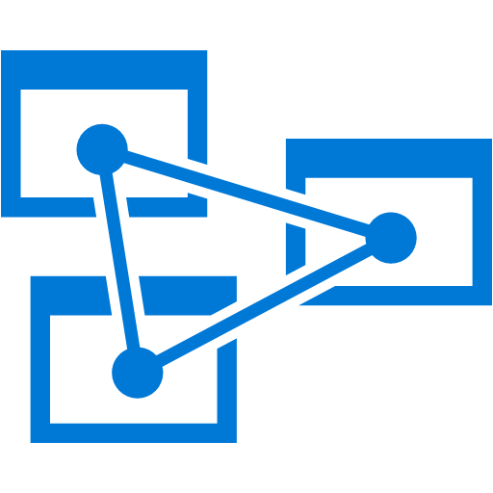

Reporting & BI
Fit for purpose
MPP database
No-SQL
Object store

Slide 11
Real-time analytics – persistence and serve layer
Fit for purpose
MPP database
No-SQL
Object store

Slide 12






T H E M O D E R N D A T A E S T A T E
LOB
CRM
Graph
Image
Social
IoT
Hybrid
Operational databases
Data warehouses Data Lakes
Operational databases
Data warehouses
Data Lakes
Reason over any data, anywhere
Flexibility of choice
Security and performance

Slide 13
T H E M I C R O S O F T O F F E R I N G
LOB
CRM
Graph
Image
Social
IoT
SQL Server
Hybrid
Azure Data Services
Easiest lift and shift with no code changes
Industry leader 2 years in a row
Operational databases
Data warehouses
Operational databases
Data warehouses
Data lakes
70% faster than Aurora
2x global reach than Redshift
No Limits Analytics with 99.9% SLA
#1 TPC-H performance
T-SQL query over any data Data lakes
AI built-in | Most secure | Lowest TCO
Reason over any data, anywhere
Flexibility of choice
Security and performance

Slide 15





K N O W I N G T H E V A R I O U S B I G D A T A S O L U T I O N S
CONTROL
EASE OF USE
Reduced Administration
Azure Data Lake Analytics
Data Engineering in a Job-as-a-service model
Azure Databricks
Frictionless & Optimized
Spark clusters
Azure HDInsight
Workload optimized,
managed clusters
Azure Marketplace
HDP | CDH | MapR
Any Hadoop technology, any distribution
BIG DATA ANALYTICS
IaaS Clusters
Managed Clusters Big Data as-a-service
Azure Data Lake Store
Azure Storage
BIG DATA STORAGE

Slide 16








BI G D ATA & AD V AN C ED AN A LY T I C S AT A G L AN C E
Ingest Store
Data Factory
(Data movement, pipelines & orchestration)
Prep & Train
Model & Serve
Intelligence
Business apps
Cosmos DB
Predictive apps
Blobs Data Lake
Databricks
Custom apps
Kafka
10
01
HDInsight
Data Lake Analytics
SQL
SQL Database
SQL Data Warehouse
Operational reports
Event Hub IoT Hub
Machine Learning
Sensors and devices
Analysis Services
Analytical dashboards

Slide 17



Slide 18








Why Spark?

Slide 19



What is Azure Databricks?
A fast, easy and collaborative Apache® Spark™ based analytics platform optimized for Azure
Best of Databricks
Best of Microsoft
Designed in collaboration with the founders of Apache Spark
One-click set up; streamlined workflows
Interactive workspace that enables collaboration between data scientists, data engineers, and business analysts. Native integration with Azure services (Power BI, SQL DW, Cosmos DB, Blob Storage)
Enterprise- grade Azure security (Active Directory integration, compliance, enterprise -grade SLAs)

Slide 20








A P A C H E S P A R K
An unified, open source, parallel, data processing framework for Big Data Analytics
Spark SQL
Interactive Queries
Spark MLlib
Machine Learning
Spark Streaming
Stream processing
GraphX
Graph Computation
Spark Core Engine
Yarn
Mesos
Standalone Scheduler

Slide 21
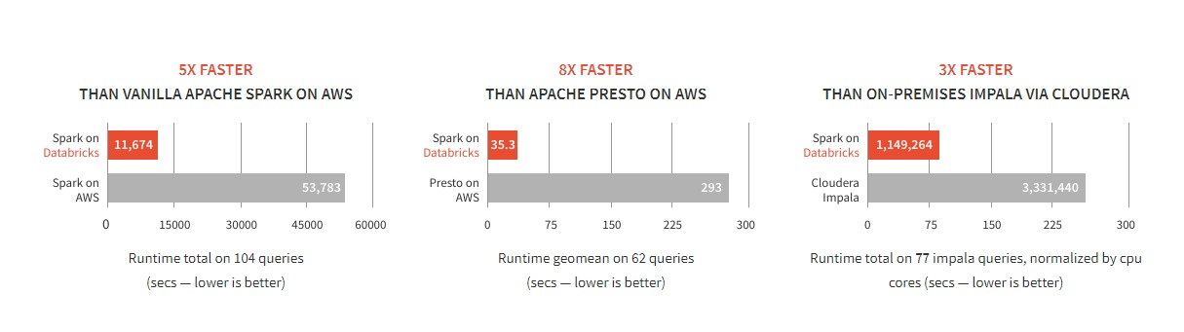
D A T A B R I C K S S P A R K I S F A S T
Benchmarks have shown Databricks to often have better performance than alternatives
SOURCE: Benchmarking Big Data SQL Platforms in the Cloud

Slide 22
Differentiated experience on Azure
ENHANCE PRODUCTIVITY
Get started quickly by launching your new Spark environment with one click.
Share your insights in powerful ways through rich integration with Power BI.
Improve collaboration amongst your analytics team through a unified workspace.
Innovate faster with native integration with rest of Azure platform
BUILD ON THE MOST COMPLIANT CLOUD
SCALE WITHOUT LIMITS
Simplify security and identity control with built-in integration with Active Directory.
Regulate access with fine-grained user permissions to Azure Databricks’ notebooks, clusters, jobs and data.
Operate at massive scale
without limits globally.
Accelerate data processing with the fastest Spark engine.
Build with confidence on the trusted cloud backed by unmatched support, compliance and SLAs.

Slide 23










Azure Databricks
Azure Databricks
Collaborative Workspace
IoT / streaming data
Machine learning models
DATA ENGINEER BUSINESS ANALYST
DATA SCIENTIST
Deploy Production Jobs & Workflows
Cloud storage
BI tools
MULTI-STAGE PIPELINES JOB SCHEDULER NOTIFICATION & LOGS
Data warehouses
Optimized Databricks Runtime Engine
Data exports
Hadoop storage
DATABRICKS I/O APACHE SPARK SERVERLESS Rest APIs
Data warehouses
Enhance Productivity
Build on secure & trusted cloud
Scale without limits

Slide 24











Collaborative Workspace
Azure Databricks
Collaborative Workspace
DATA ENGINEER
DATA SCIENTIST
BUSINESS ANALYST
Deploy Production Jobs & Workflows
MULTI-STAGE PIPELINES
JOB SCHEDULER
NOTIFICATION & LOGS
Optimized Databricks Runtime Engine
DATABRICKS I/O
APACHE SPARK
SERVERLESS
Rest APIs

Slide 25




Deploy Production Jobs & Workflows
Azure Databricks
Collaborative Workspace DATA ENGINEER DATA SCIENTIST |  |  | BUSINESS ANALYST
 | Deploy Production Jobs & Workflows MULTI-STAGE PIPELINES JOB SCHEDULER |  | NOTIFICATION & LOGS
 | Optimized Databricks Runtime Engine DATABRICKS I/O APACHE SPARK | SERVERLESS | Rest APIs

Slide 26









A R T I F A C T S
A Z U R E
D A T A B R I C K S
C O R E
Azure Databricks

Slide 27




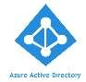

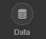
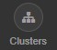

A Z U R E D A T A B R I C K S I N T E G R A T I O N W I T H A A D
Azure Databricks is integrated with AAD—so Azure Databricks users are just regular AAD users
There is no need to define users—and their access control—separately in Databricks.
AAD users can be used directly in Azure Databricks for all user-based access control (Clusters, Jobs, Notebooks etc.).
Databricks has delegated user authentication to AAD enabling single-sign on (SSO) and unified authentication.
Notebooks, and their outputs, are stored in the Databricks account. However, AAD- based access-control ensures that only authorized users can access them.
Azure Databricks
Access Control
Authentication

Slide 28
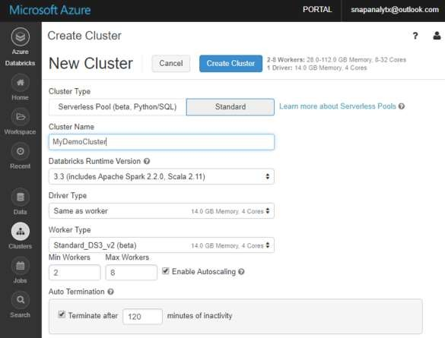
C L U S T E R S : A U T O S C A L I N G A N D A U T O T E R M I N A T I O N
Simplifies cluster management and reduces costs by eliminating wastage
When creating Azure Databricks clusters you can choose Autoscaling and Auto Termination options.
Autoscaling: Just specify the min and max number of clusters. Azure Databricks automatically scales up or down based on load.
Auto Termination: After the specified minutes of inactivity the cluster is automatically terminated.
Benefits:
You do not have to guess, or determine by trial and error, the correct number of nodes for the cluster
As the workload changes you do not have to manually tweak the number of nodes
You do not have to worry about wasting resources when the cluster is idle. You only pay for resource when they are actually being used
You do not have to wait and watch for jobs to complete just so you can shutdown the clusters

Slide 29

J O B S
Jobs are the mechanism to submit Spark application code for execution on the Databricks clusters
Spark application code is submitted as a ‘Job’ for execution on
Azure Databricks clusters
Jobs execute either ‘Notebooks’ or ‘Jars’
Azure Databricks provide a comprehensive set of graphical tools to create, manage and monitor Jobs.

Slide 30
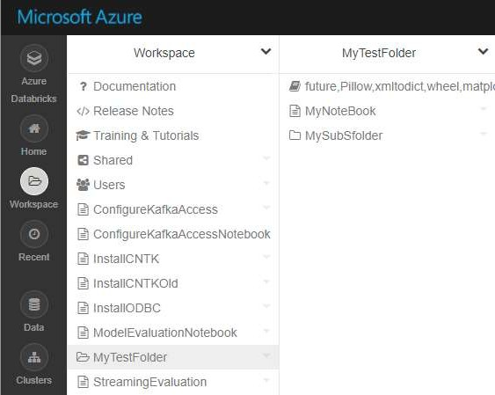

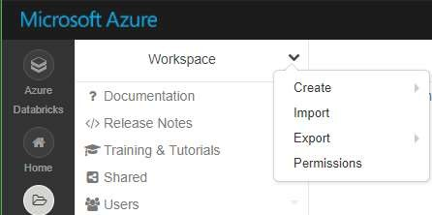
W O R K S P A C E S
Workspaces enables users to organize—and share—their Notebooks, Libraries and Dashboards
Icons indicate the type of the object contained in a folder
By default, the workspace and all its contents are available to users.

Slide 31
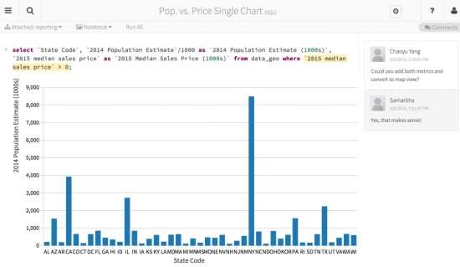


A Z U R E D A T A B R I C K S N O T E B O O K S O V E R V I E W
Notebooks are a popular way to develop, and run, Spark Applications
Notebooks are not only for authoring Spark applications but can be run/executed directly on clusters
Shift+Enter
•
•
Notebooks support fine grained permissions—so they can be securely shared with colleagues for collaboration (see following slide for details on permissions and abilities)
Notebooks are well-suited for prototyping, rapid development, exploration, discovery and iterative development
Notebooks typically consist of code, data, visualization, comments and notes

Slide 32
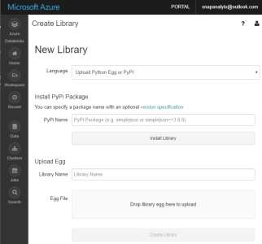
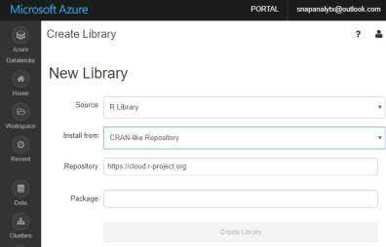
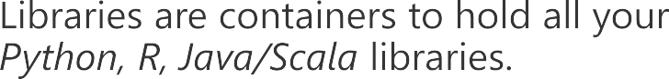
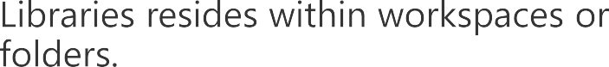
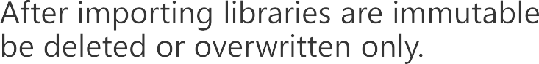
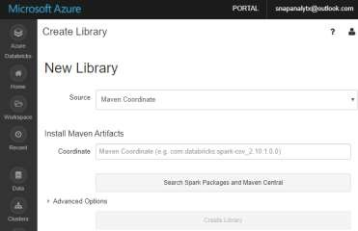
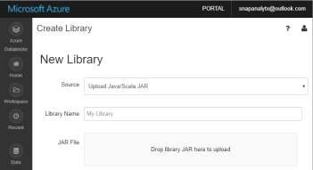
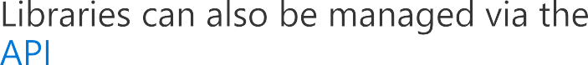
L I B R A R I E S O V E R V I E W
Enables external code to be imported and stored into a Workspace

Slide 33
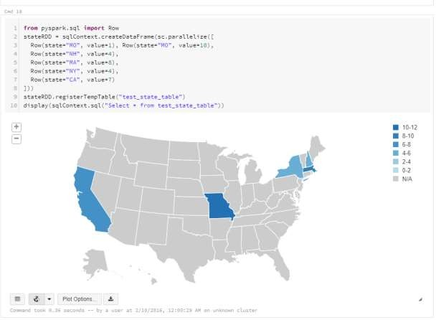
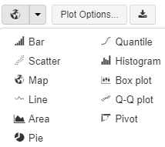
V I S U A L I Z A T I O N
Azure Databricks supports a number of visualization plots out of the box
All notebooks, regardless of their language, support Databricks visualizations.
When you run the notebook the visualizations
are rendered inside the notebook in-place
The visualizations are written in HTML.
You can save the HTML of the entire notebook by exporting to HTML.
If you use Matplotlib, the plots are rendered as images so you can just right click and download the image
You can change the plot type just by picking from the selection

Slide 34
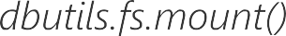

D A T A B R I C K S F I L E S Y S T E M ( D B F S )
Is a distributed File System (DBFS) that is a layer over Azure Blob Storage
Python
Scala
CLI
dbutils
DBFS
Azure Blob Storage

Slide 35


Slide 36
Modern Big Data Warehouse
Ingest
Store
Prep & Train
Model & Serve
Intelligence
Logs, files and media (unstructured)
Data factory
Azure storage
Azure Databricks (Spark)
Business / custom apps (Structured)
Polybase
Data factory
Azure SQL Data Warehouse
Analytical dashboards

Slide 37


Advanced Analytics on Big Data
Ingest
Store
Prep & Train
Model & Serve
Intelligence
Logs, files and media (unstructured)
Data factory
Azure storage
Azure Databricks (Spark Mllib, SparkR, SparklyR)
Azure Cosmos DB
Web & mobile apps
Business / custom apps (Structured)
Polybase
Data factory
Azure SQL Data Warehouse
Analytical dashboards

Slide 38
Real-time analytics on Big Data
Ingest
Store
Prep & Train
Model & Serve
Intelligence
Unstructured data
Azure HDInsight (Kafka)
Azure Databricks (Spark)
Polybase
Azure storage
Azure SQL Data Warehouse
Analytical dashboards

Slide 39
Big Data OSS - Comparison
Azure HDInsight (1st party + Support)
Azure Databricks (1st party + Support)
3rd Party Offerings
What it is
Hadoop (Hortonworks’ Distribution) as a managed service supporting a variety of open-source analytics engines such as Apache Spark, Hive LLAP, Storm, Kafka, HBase.
Security via Ranger (Kerberos based)
What it is
Databricks Spark, the most popular open-source analytics engine, as a managed service providing an easy and fast way to unlock big data use cases. Offers best-in-class notebooks experience for productivity and collaboration as well integration with Azure Data Warehouse, Power BI, etc
Security via native Azure AD integration
What it is
Hadoop distributions from Cloudera, MapR & Hortonworks available on Azure Marketplace as IaaS VMs.
Pricing
Priced to compete with AWS EMR. Standard offering.
Pricing
Priced to match Databricks on AWS. Premium offering.
Pricing
N/A. Vendor prices their products.
Use When
Customer prefers a PaaS like experience to address big data use cases by working with different OSS analytics engines to address big data use cases. Cost sensitive.
Use When
Customer prefers SaaS like experience to address big data use cases and values Databricks’ ease of use, productivity & collaboration features.
Use When
Customer wants to move their on premises Hadoop distribution to Azure IaaS using their existing licenses.

Slide 40





















Slide 41
Era Of Big Data
How it evolved and what is is for us in current market trends

Slide 42
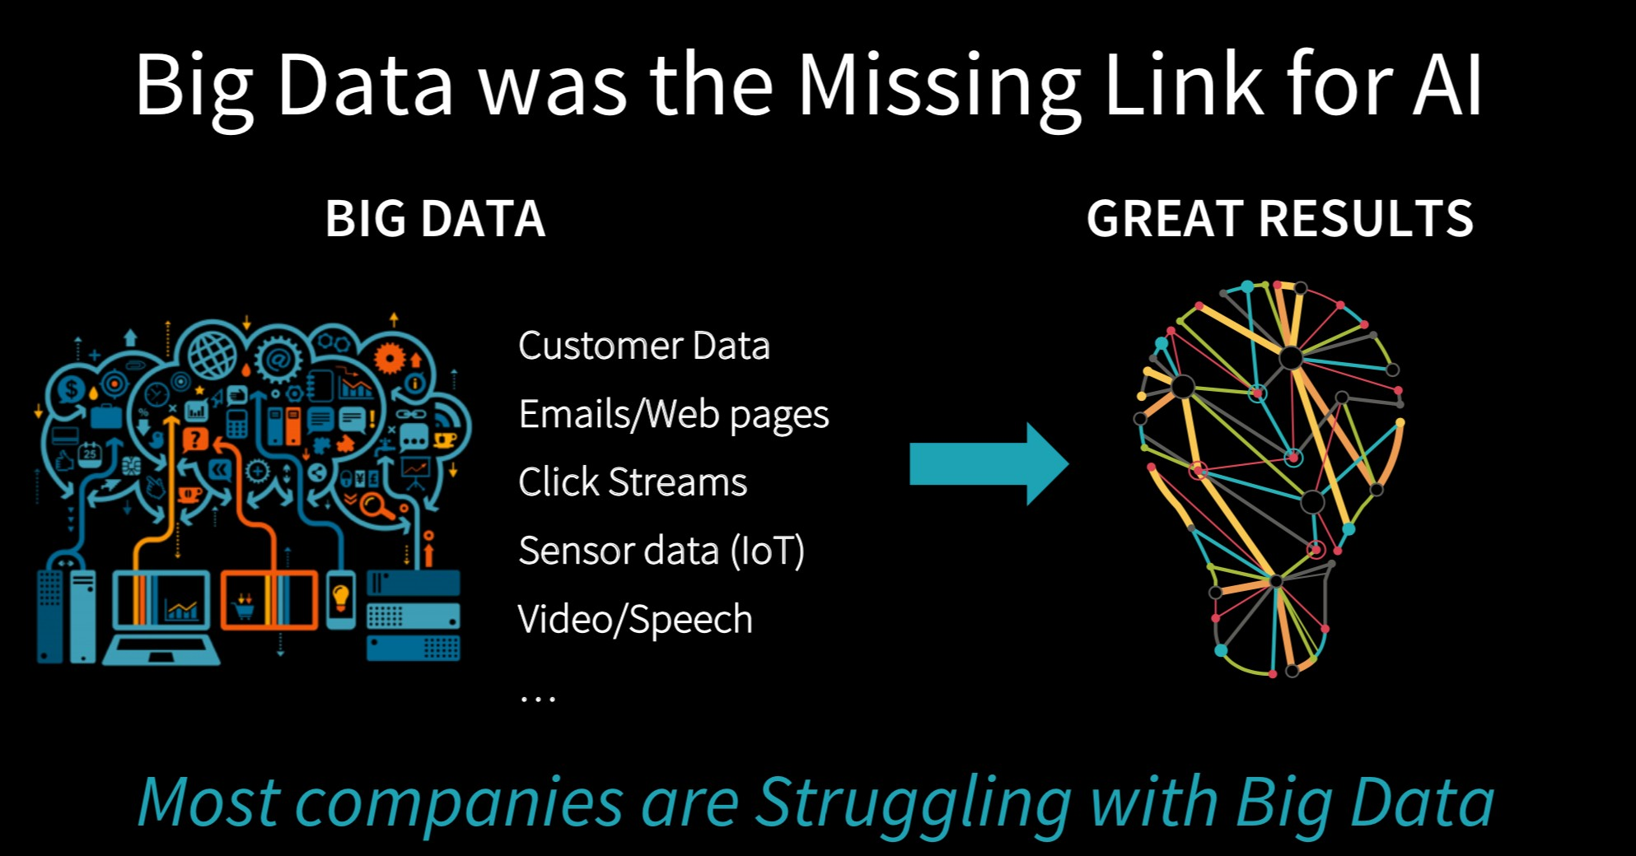

Slide 43
BigData is not only Hadoop

Slide 44
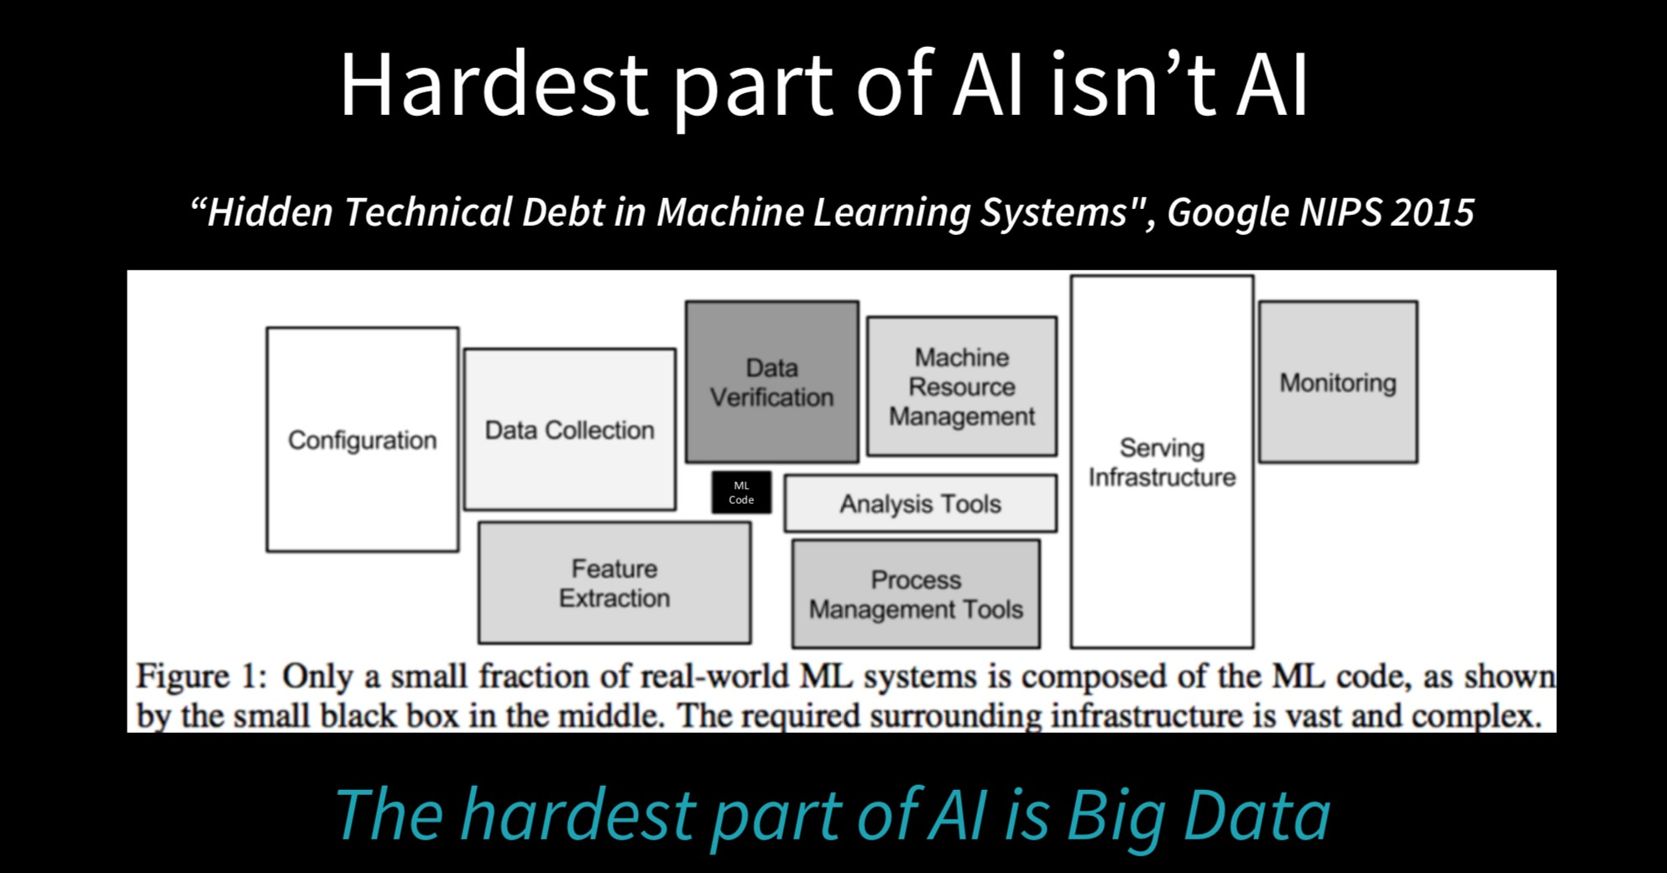

Slide 45
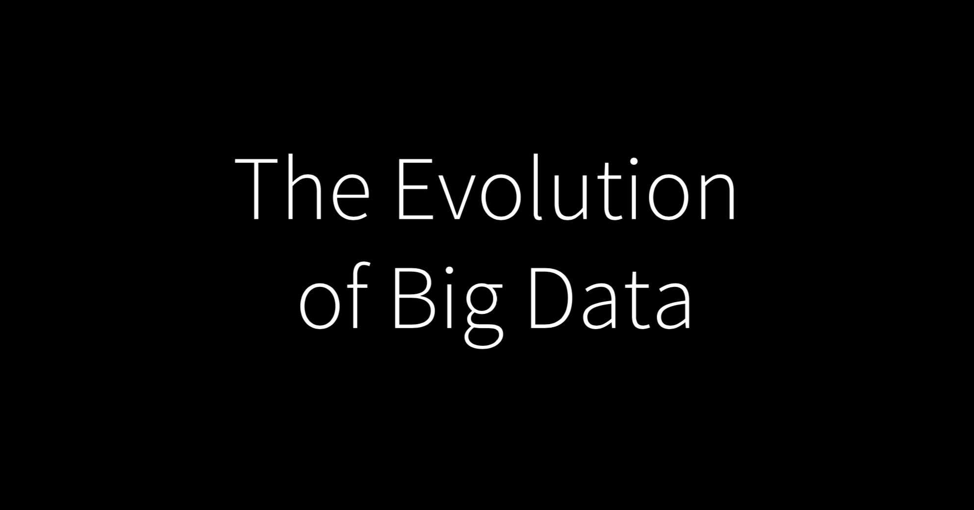

Slide 46
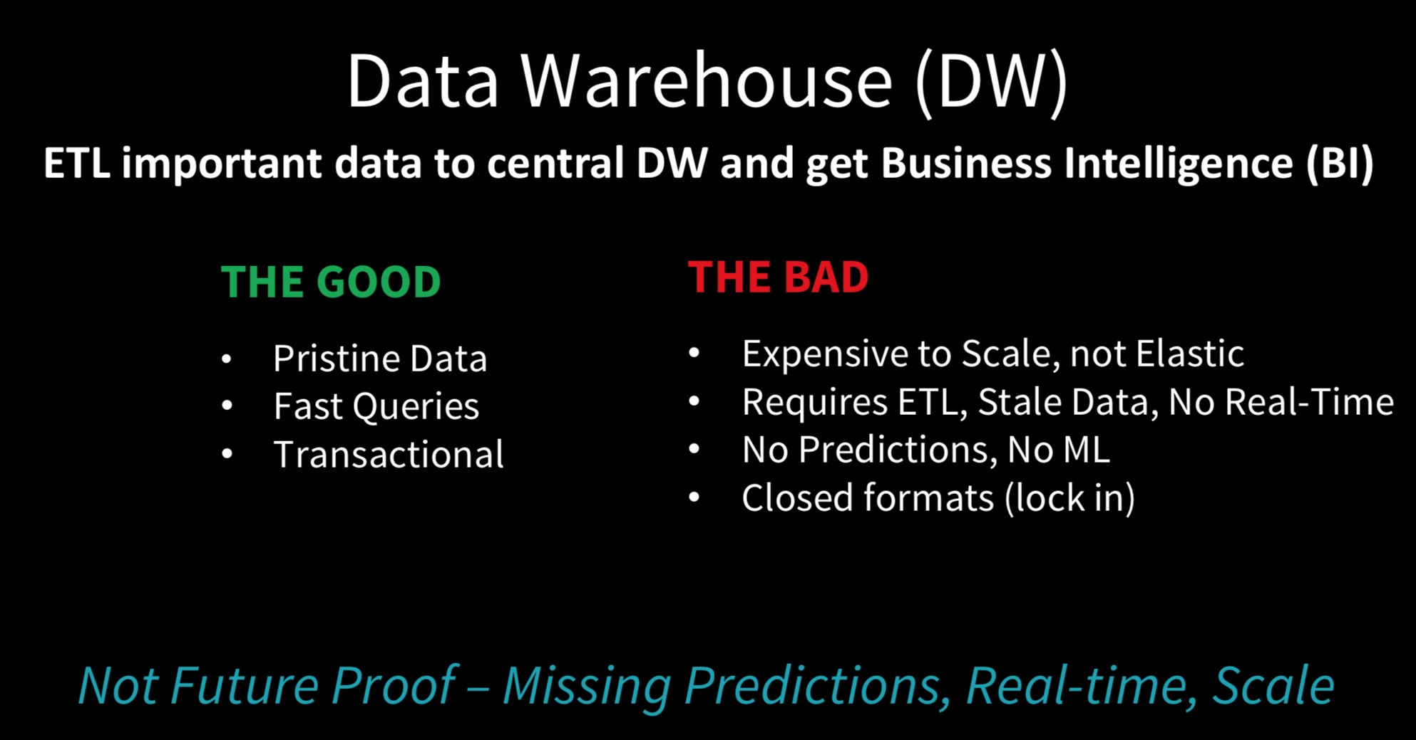

Slide 47
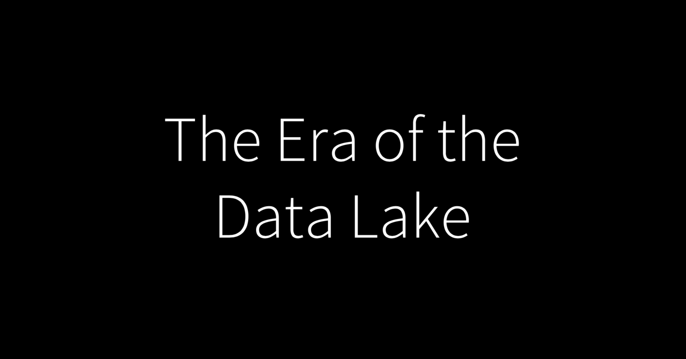

Slide 48
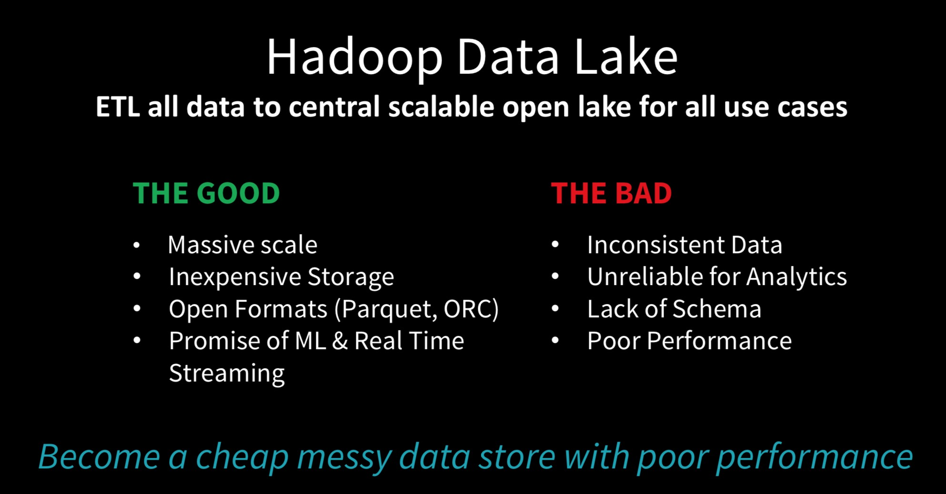

Slide 49
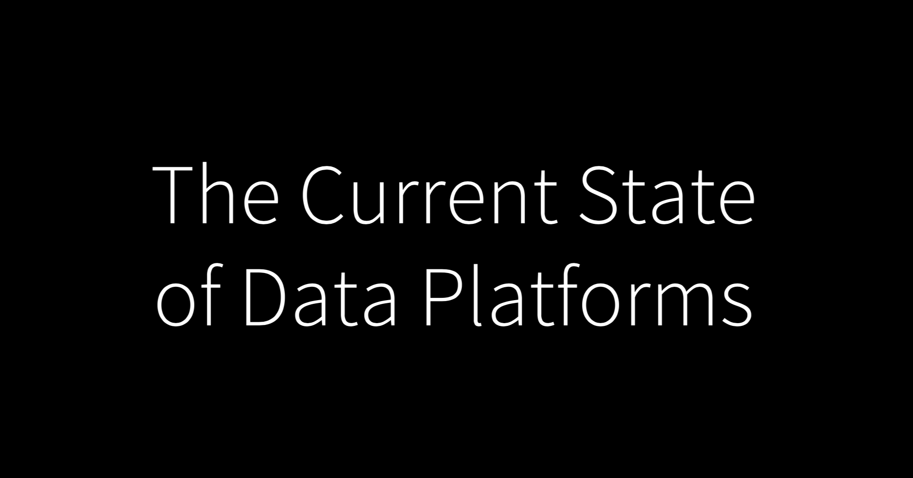

Slide 50
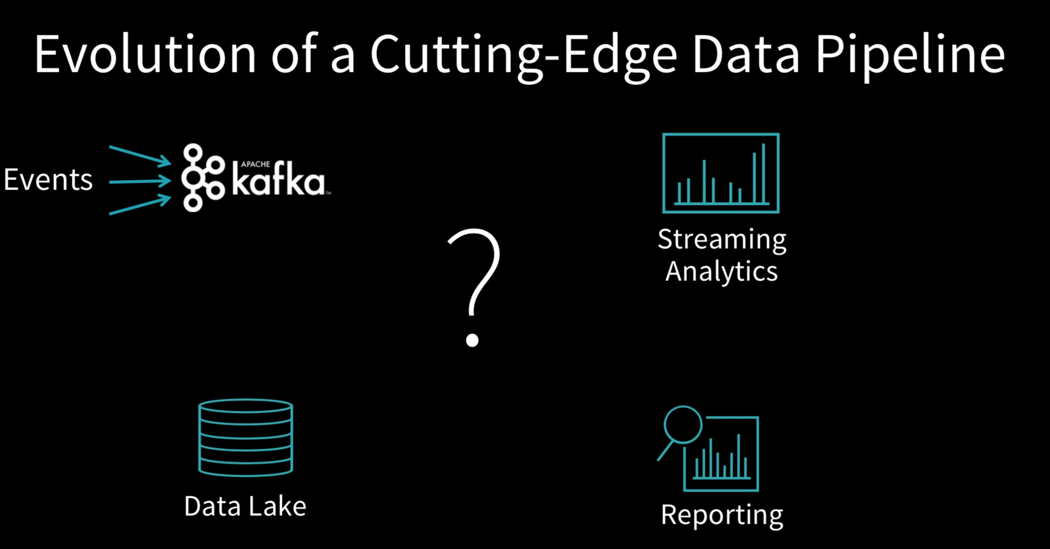

Slide 51
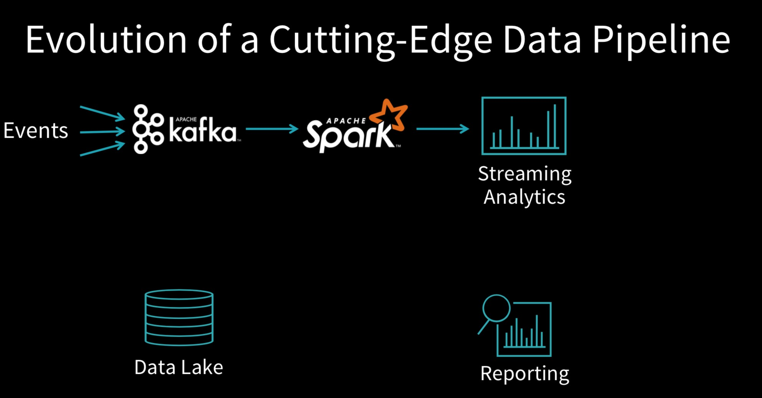

Slide 52
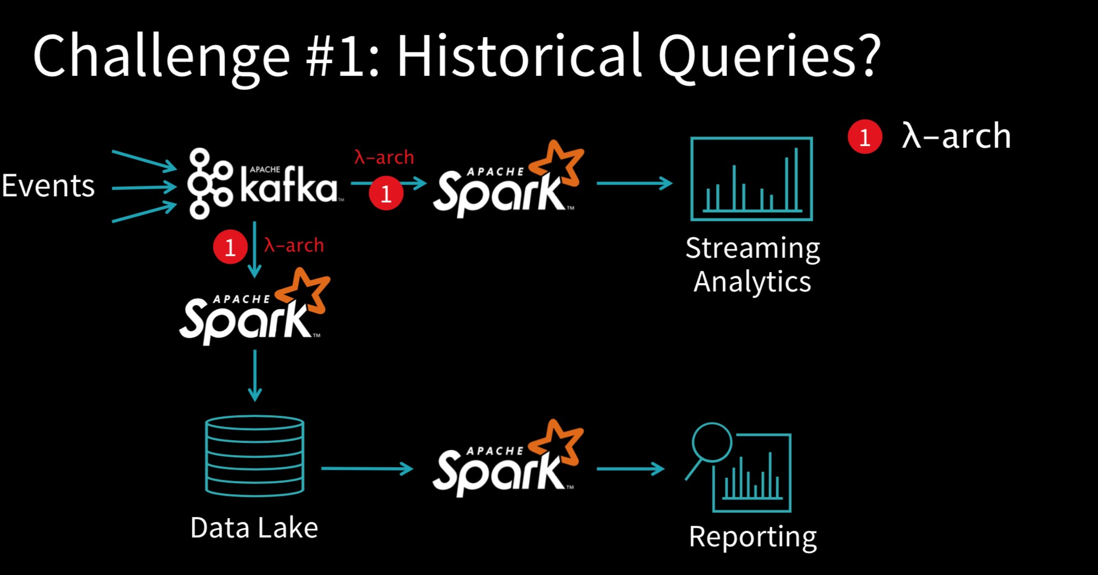

Slide 53
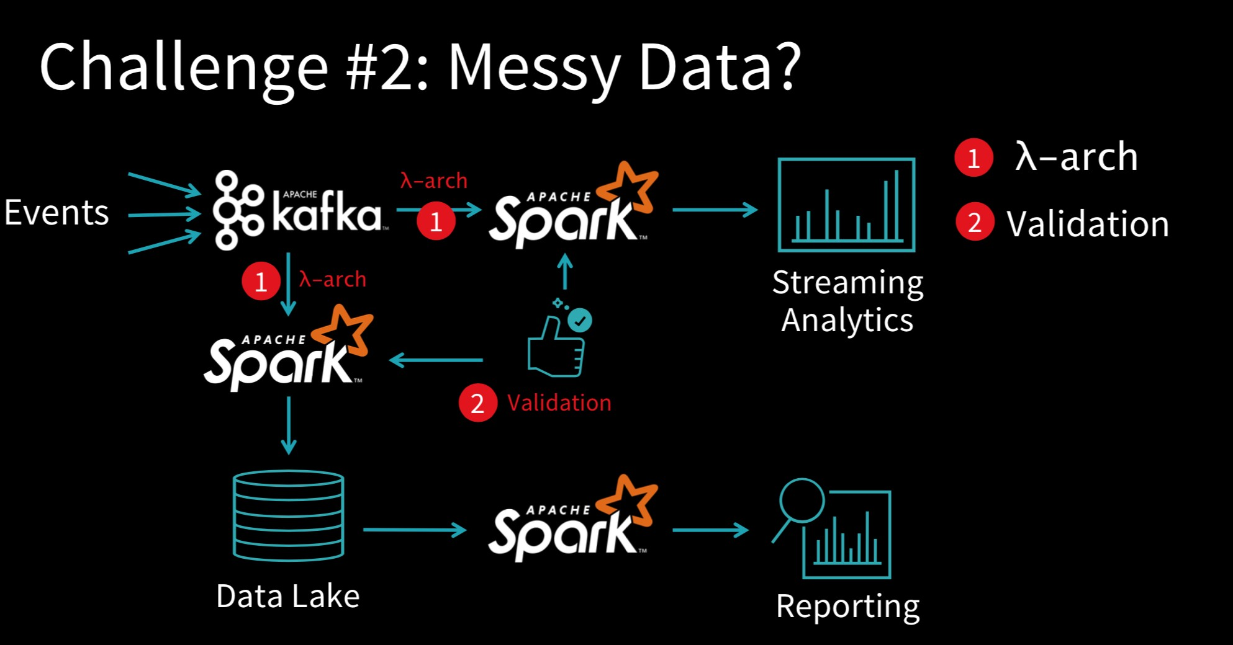

Slide 54
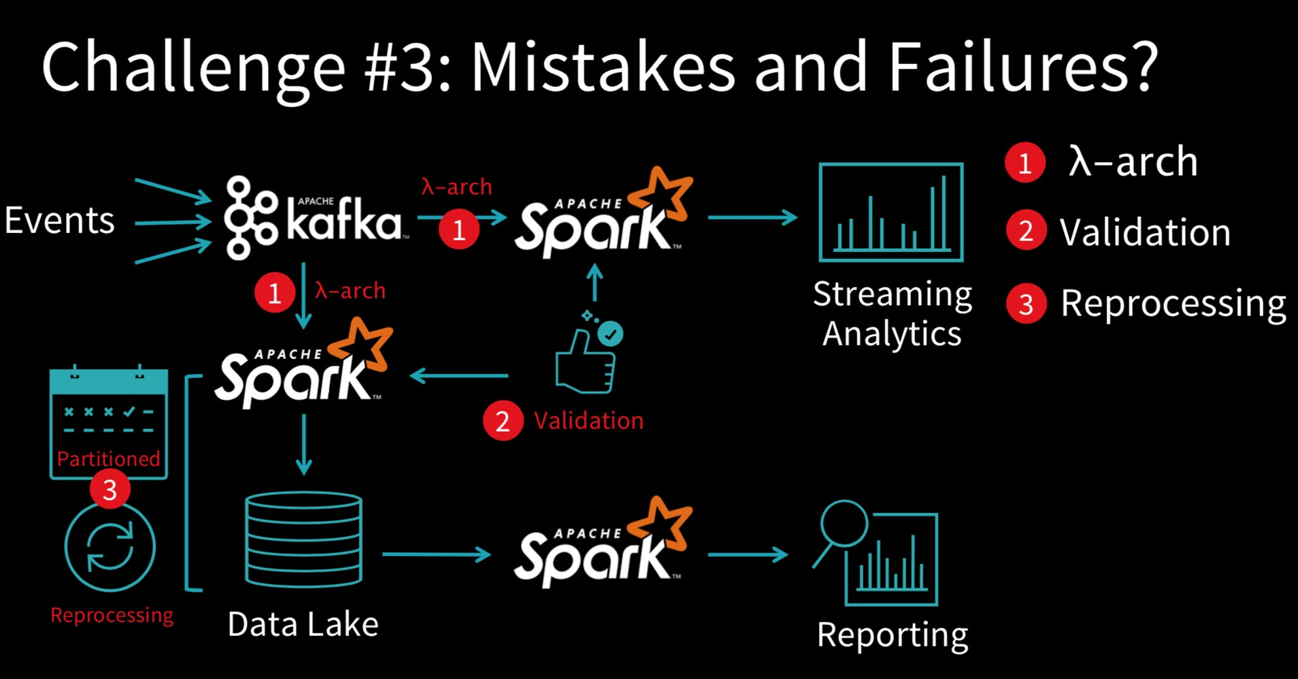

Slide 55
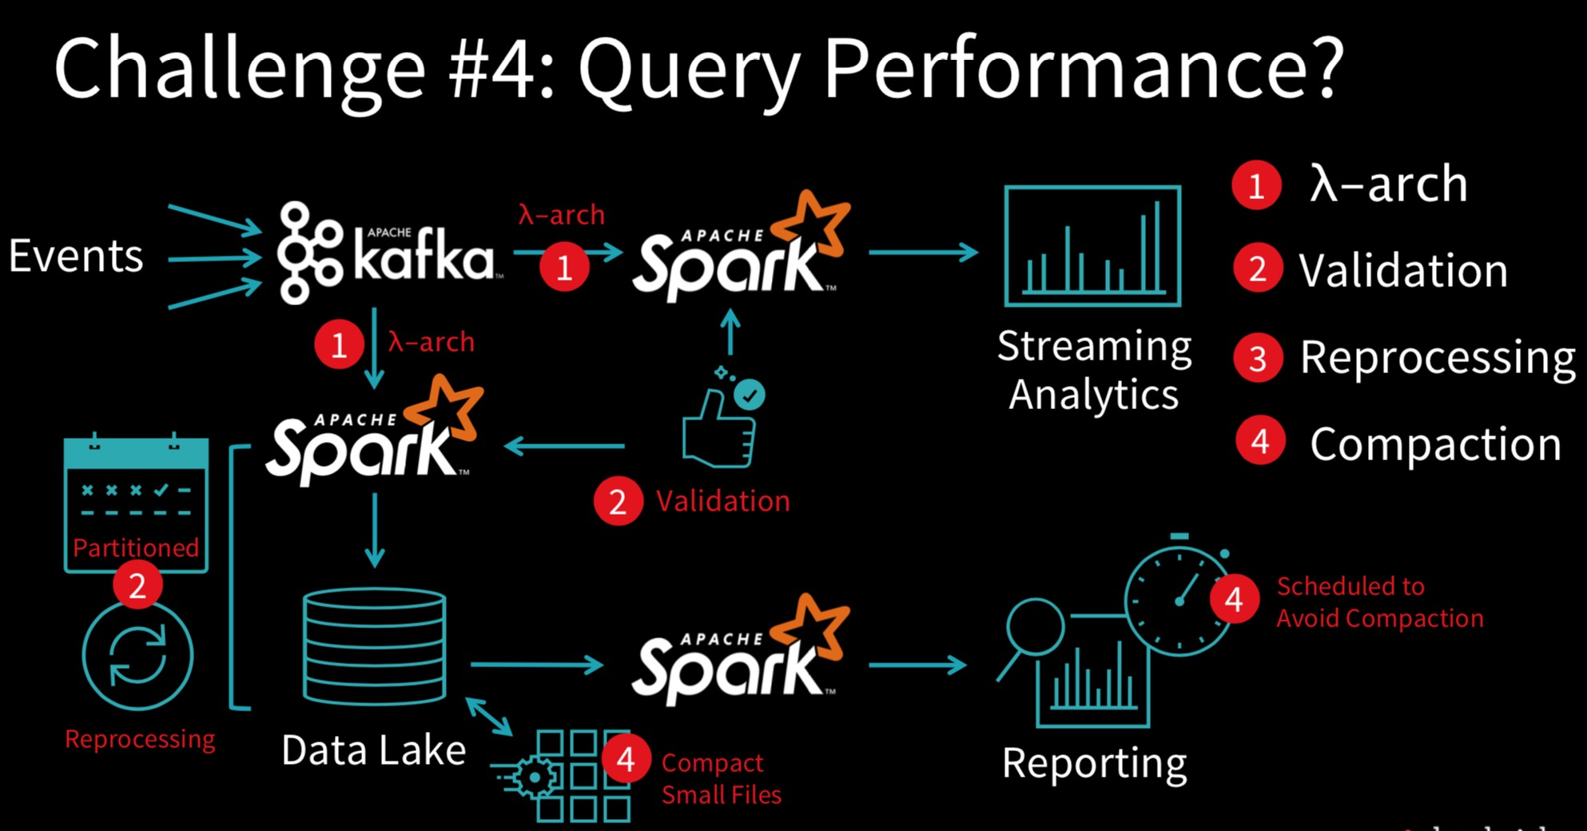

Slide 57


Databricks Delta is fundamentally…..
Delta storage format
Object store

Slide 58
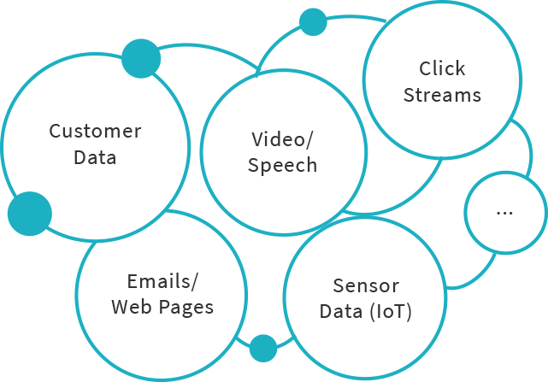




Promise of Databricks Delta
Spark on Databricks, storage format optimization for
faster analytics,
better data reliability guarantees,
and simplified data pipelines
+
Data Reliability
Faster Analytics

Slide 59
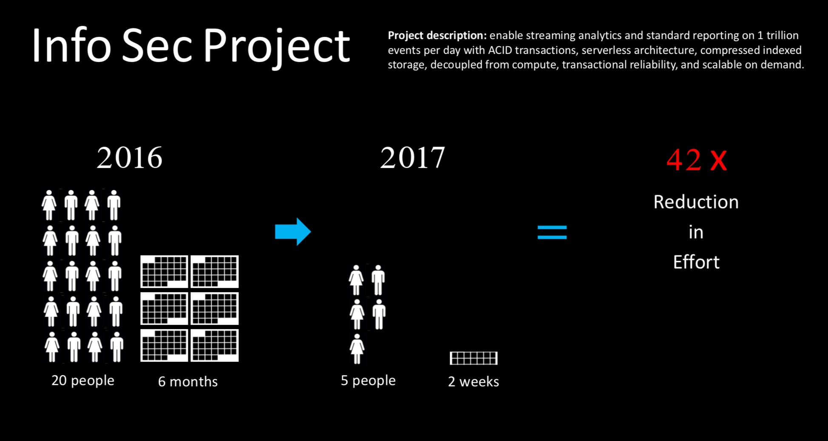

Slide 60
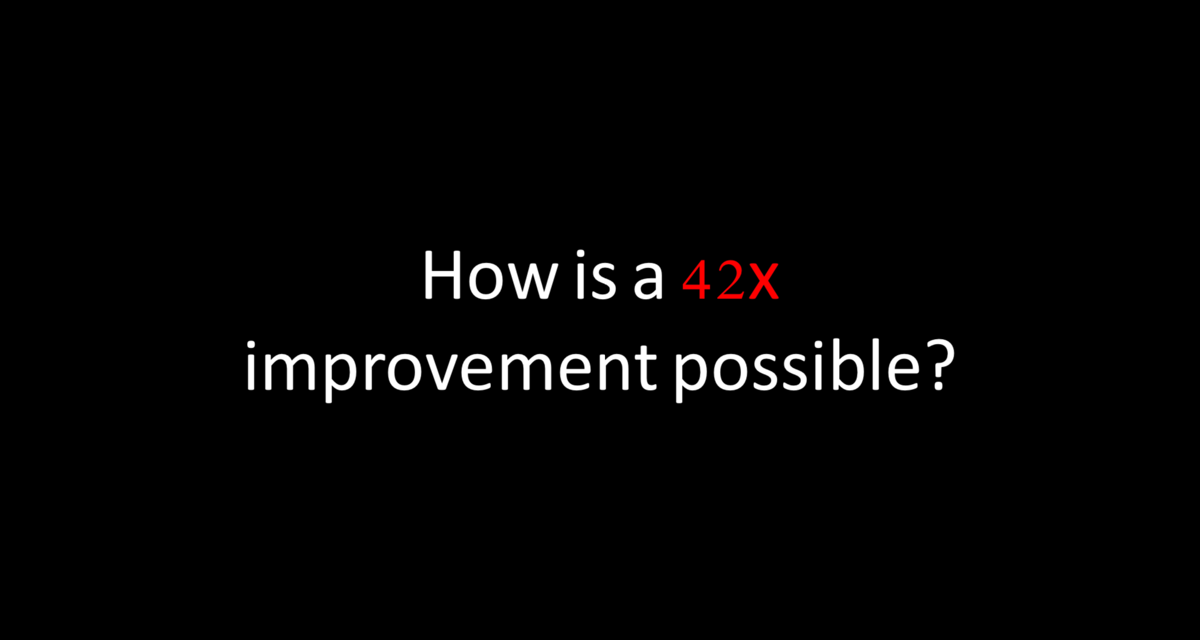

Slide 61
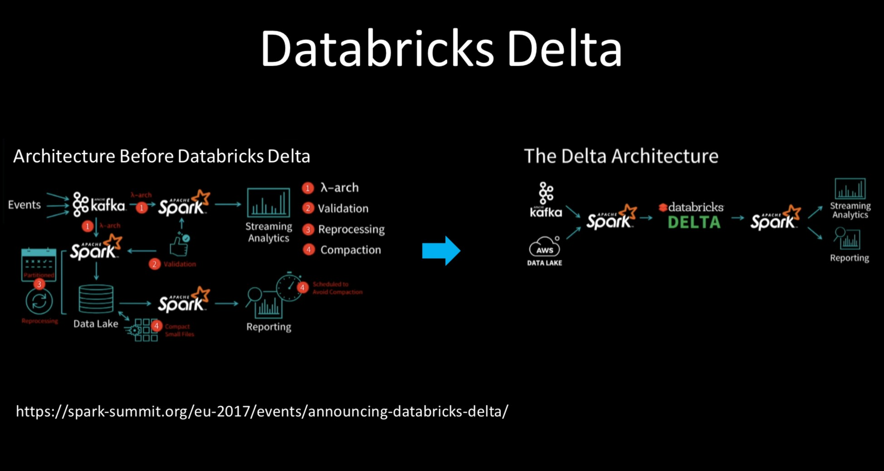

Slide 62
